Slide 1
Asynchronous Video Web Scraping Accounting Analytics – Spring 2022

Slide 2
The Plan
Today’s class agenda
Overview of Web scraping
APIs
HTML Web Scraping
Browser-based web scraping
Reminder:
Must complete the Juptyer Notebook Assignment by the due date on Canvas

Slide 3
Overview of Web Scraping
The goal of web scraping is take unstructured data online (webpages, download links, etc.) and generate structured data (CSV file, dataframe, etc.)
Why? “Data is everywhere”
Capturing new and useful data
Learn insights that traditional data providers does not track yet
Monetize…
However:
All you are really doing is data preparation
Requires an understanding of web languages (HTML, Javascript, etc.)
Some friendly websites, many unfriendly (CAPTCHA) websites
Huge time investment up front, but then can run updates easily

Slide 4
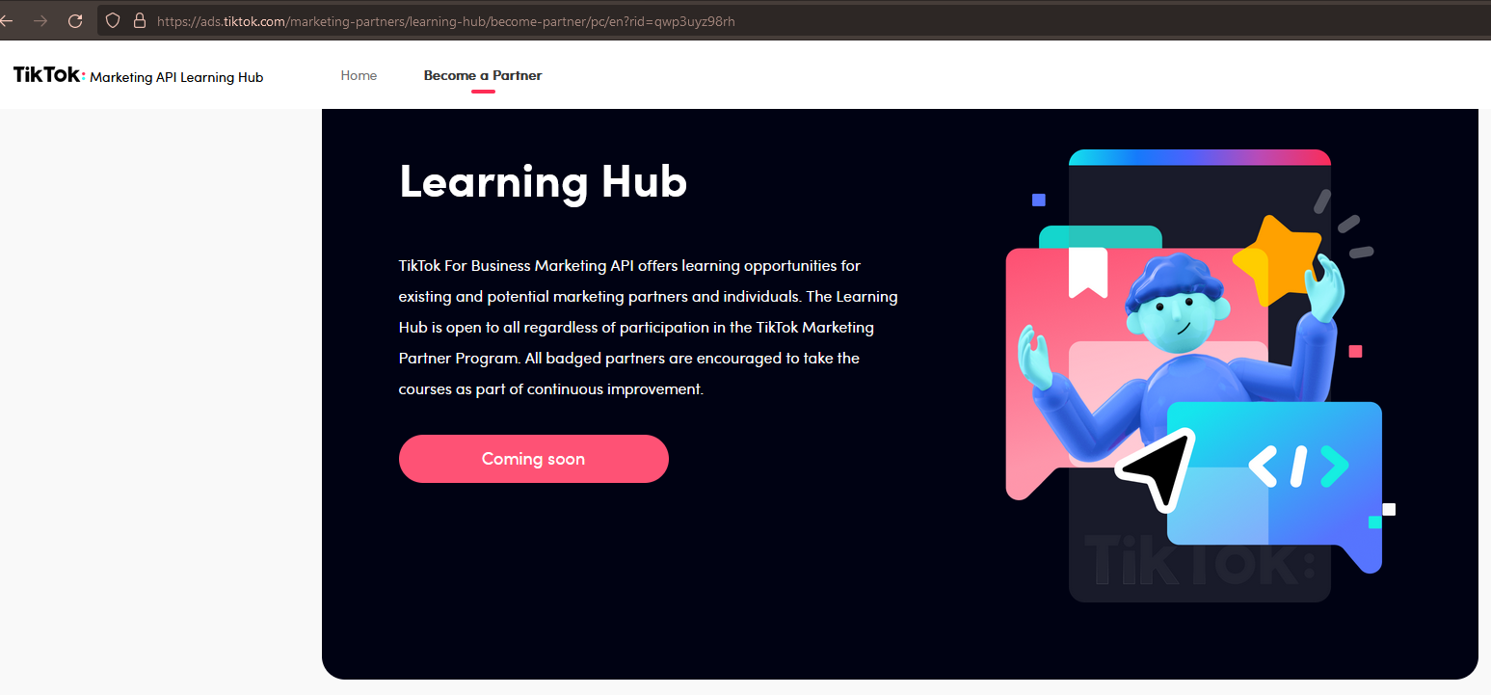
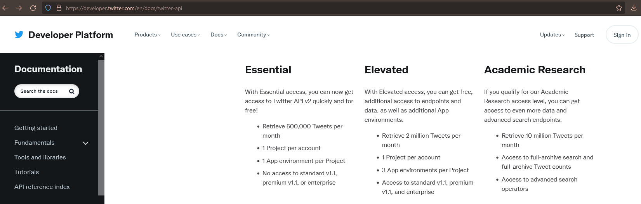
Three Types of Web Scraping
APIs
Meant to be for app developers to interact with a website multiple times
Strengths: prepackaged data that is meant for easy access by a script
Drawbacks: not available for every website, can be limited

Slide 5
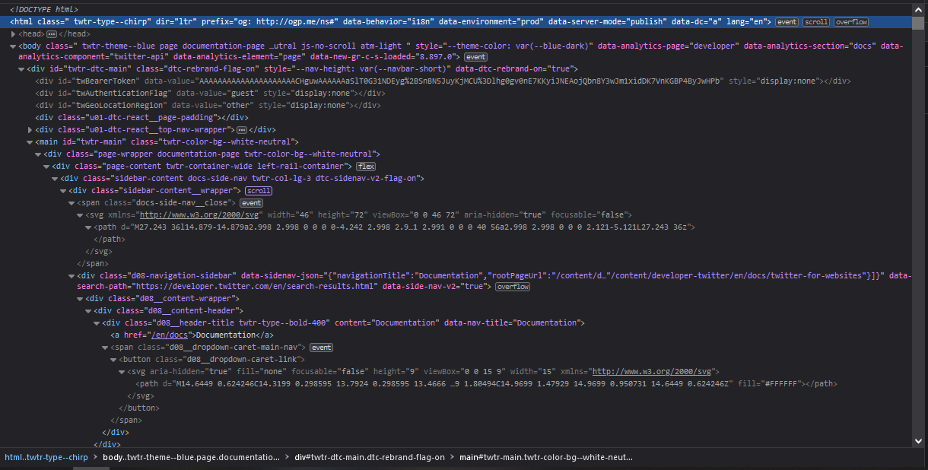
Three Types of Web Scraping
HTML Web Scraping
Downloading the “source” HTML file for a webpage
Pros: easy command to download, and then you work locally on it
Cons:
must know HTML and use regular expressions to pull out only relevant data
newer webpages are dynamically changing (endless scrolling) so the initial HTML you pull can be close to empty

Slide 6
HTML Web Scraping
Need a list of websites to visit
Tell Python to “get” the HTML from that website and save it in memory
Clean that text in memory using combination of parsers and regular expressions
Save what you want to a dataframe and then move to the next website (for loop)
Save the final dataframe to a CSV

Slide 7
Open Asynchronous Jupyter Notebook
Follow along as we work through the Jupyter Notebook

Slide 8
Three Types of Web Scraping
Browser-based Web scraping
Runs a “headless browser” (Selenium) to interact with a website
Originally intended for web developers to test certain amounts of traffic
Pros: can send JavaScript commands to get information you need (e.g., fill out search form, download results)
Cons:
Need to mimic human interaction on website
Limited by CAPTCHAs and other timeouts
Need a good understanding of both HTML and JavaScript

Slide 9
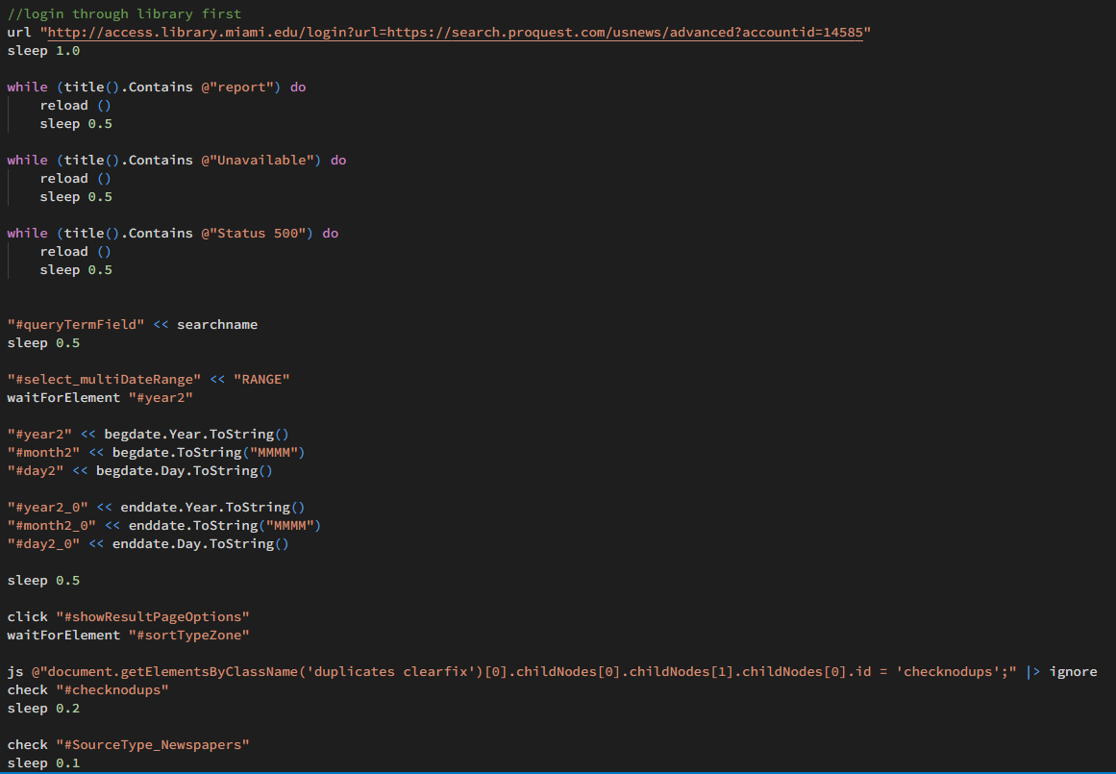
Three Types of Web Scraping
Browser-based Web scraping
Tutorial for Jupyter Notebook (requires installing selenium package + driver)

